Slide 1
Wireless LAN Technology

Slide 2
Wireless LAN Applications
LAN Extension
Cross-building interconnect
Nomadic Access
Ad hoc networking

Slide 3
LAN Extension
Wireless LAN linked into a wired LAN on same premises
  Wired LAN
    Backbone
    Support servers and stationary workstations
  Wireless LAN
    Stations in large open areas
    Manufacturing plants, stock exchange trading floors, and warehouses

Slide 4
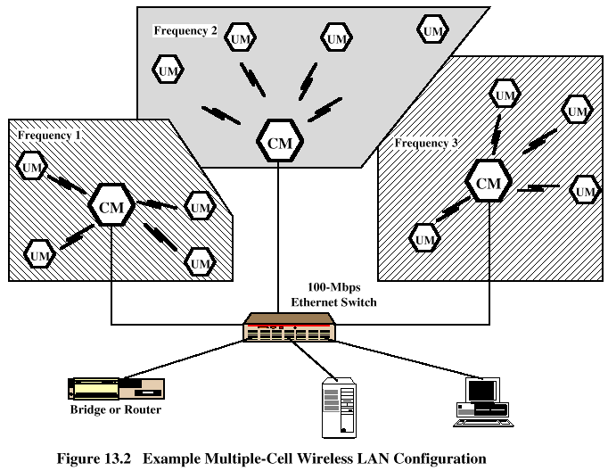
Multiple-cell Wireless LAN

Slide 5
Cross-Building Interconnect
Connect LANs in nearby buildings
  Wired or wireless LANs
Point-to-point wireless link is used
Devices connected are typically bridges or routers

Slide 6
Nomadic Access
Wireless link between LAN hub and mobile data terminal equipped with antenna
  Laptop computer or notepad computer
Uses:
  Transfer data from portable computer to office server
  Extended environment such as campus

Slide 7
Ad Hoc Networking
Temporary peer-to-peer network set up to meet immediate need
Example:
  Group of employees with laptops convene for a meeting; employees link computers in a temporary network for duration of meeting

Slide 8
Wireless LAN Requirements
Throughput
Number of nodes
Connection to backbone LAN
Service area
Battery power consumption
Transmission robustness and security
Collocated network operation
License-free operation
Handoff/roaming
Dynamic configuration

Slide 9
Wireless LAN Categories
Infrared (IR) LANs
Spread spectrum LANs
Narrowband microwave

Slide 10
Strengths of Infrared Over Microwave Radio
Spectrum for infrared virtually unlimited
  Possibility of high data rates
Infrared spectrum unregulated
Equipment inexpensive and simple
Reflected by light-colored objects
  Ceiling reflection for entire room coverage
Doesn’t penetrate walls
  More easily secured against eavesdropping
  Less interference between different rooms

Slide 11
Drawbacks of Infrared Medium
Indoor environments experience infrared background radiation
  Sunlight and indoor lighting
  Ambient radiation appears as noise in an infrared receiver
  Transmitters of higher power required
    Limited by concerns of eye safety and excessive power consumption
  Limits range

Slide 12
IR Data Transmission Techniques
Directed Beam Infrared
Ominidirectional
Diffused

